Slide 1







The Soil Uses
Different types of Soil
2022-1-BG01-KA220-SCH-000085065

Slide 2
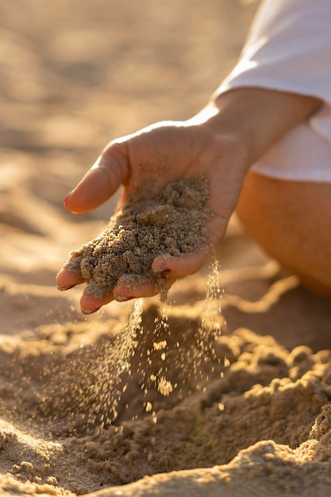
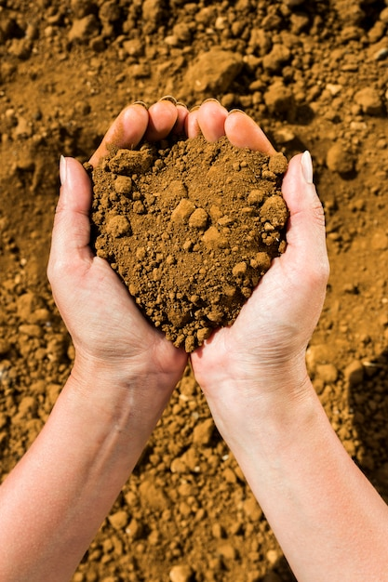
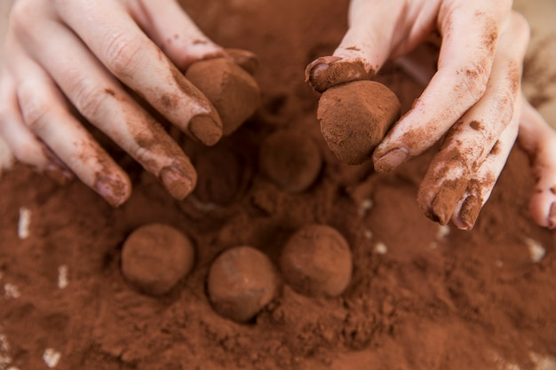
Types of Soil
Sandy
Clay
Sandy

Slide 3
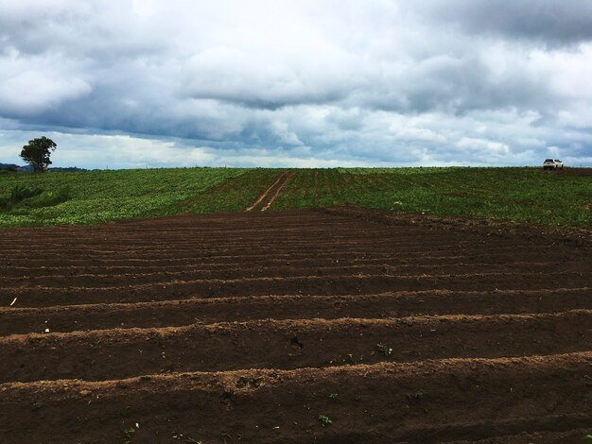
Loamy Soil
This type of soil is considered ideal for most plants, as it offers good drainage, water retention and nutrients and is therefore perfect for agriculture.

Slide 4
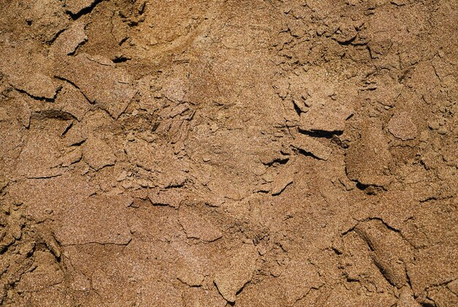
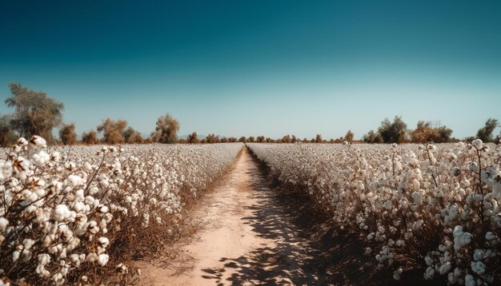
Sandy Soil
Today, the sandy soil is responsible for a significant part of the production of soya, corn, cotton, melons, mangoes and wood for cellulose, among other products.

Slide 5
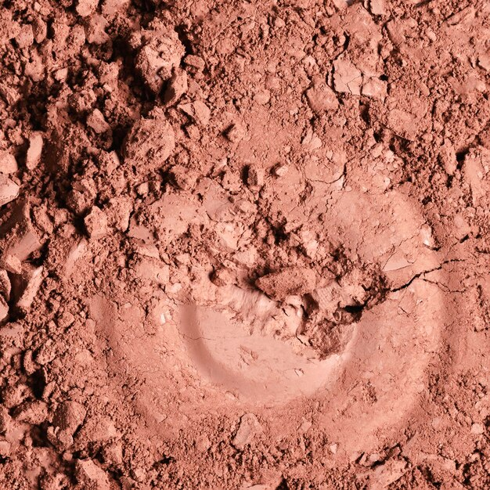
Clay Soil
Outside of agriculture, it is used as a raw material to make utensils and ceramics, as well as being used to make ceramic tiles and bricks in order to build houses.
Freepik

Slide 6
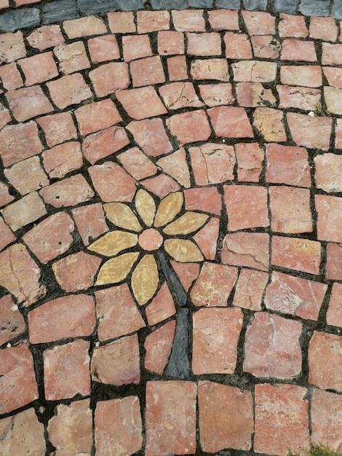



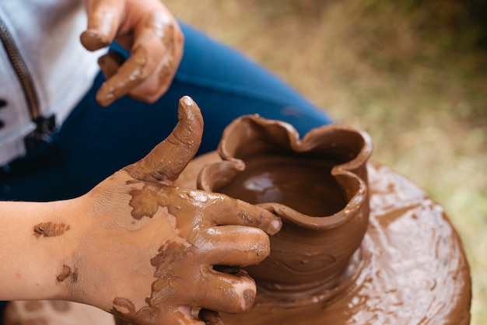

Art from different types of soil
Imagens Freepik

Slide 7
2022-1-BG01-KA220-SCH-000085065
Subject: Natural Science
Age of students: 9 – 10 years old
Topic: Nature
Resource Title: Soil Permeability
Credits: AECE – Escola Básica da Zona Verde
All media are within the EU intellectual property law.
The European Commission’s support for this publication does not constitute an endorsement of the contents, which reflect the views only of the authors, and the Commission cannot be held responsible for any use which may be made of the information contained herein.

